Slide 1

Java - Polymorphism

Slide 2
What is Polymorphism :
Polymorphism is the ability of an object to take on many forms. The most common use of polymorphism in OOP occurs when a parent class reference is used to refer to a child class object.

Slide 3


What is Polymorphism in Java with Real-Time Example :

Slide 4
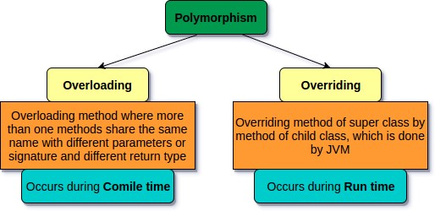
Types of Polymorphism in Java
There are two types of polymorphism in Java and they are as follows:

Slide 5
Method Overloading in Java
If a class has multiple methods having same name but different in parameters, it is known as Method Overloading.
Advantage of method overloading
Method overloading increases the readability of the program.
Different ways to overload the method
There are two ways to overload the method in java
By changing number of arguments
By changing the data type

Slide 6
Method Overloading: changing no. of arguments
class Adder{
static int add(int a,int b){return a+b;}
static int add(int a,int b,int c){return a+b+c;}
}
class TestOverloading1{
public static void main(String[] args){
System.out.println(Adder.add(11,11));
System.out.println(Adder.add(11,11,11));
}}

Slide 7
Method Overloading: changing data type of arguments
class Adder{
static int add(int a, int b){return a+b;}
static double add(double a, double b){return a+b;}
}
class TestOverloading2{
public static void main(String[] args){
System.out.println(Adder.add(11,11));
System.out.println(Adder.add(12.3,12.6));
}}

Slide 8
Why Method Overloading is not possible by changing the return type of method only ?
In java, method overloading is not possible by changing the return type of the method only because of ambiguity. Let's see how ambiguity may occur:

Slide 9
Method Overriding in Java
If subclass (child class) has the same method as declared in the parent class, it is known as method overriding in Java.
Usage of Java Method Overriding
1. Method overriding is used to provide the specific implementation of a method which is already provided by its superclass.
2. Method overriding is used for runtime polymorphism

Slide 10
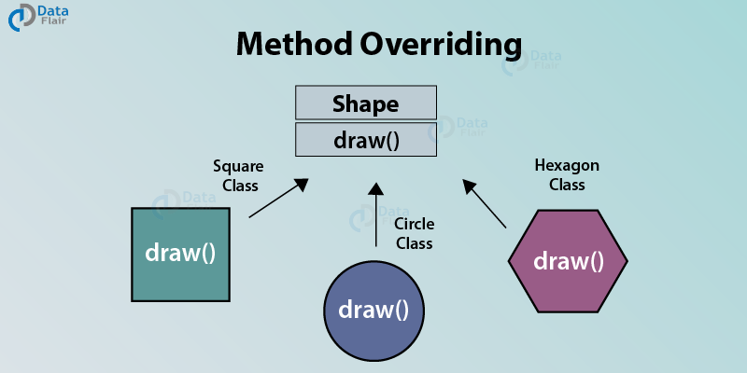
Rules for Java Method Overriding

Slide 11
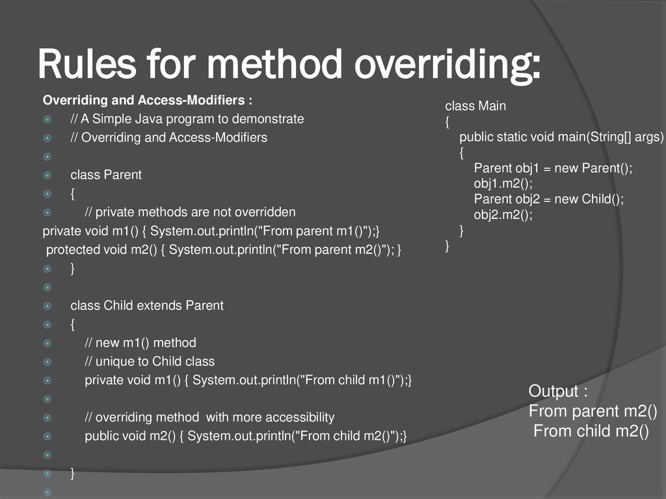
Rules for Java Method Overriding

Slide 12
Example of method overriding
class Vehicle{
void run(){System.out.println("Vehicle is running");}
}
class Bike2 extends Vehicle{
void run(){System.out.println("Bike is running safely");}
public static void main(String args[]){
Bike2 obj = new Bike2();//creating object
obj.run();
}
}

Slide 13
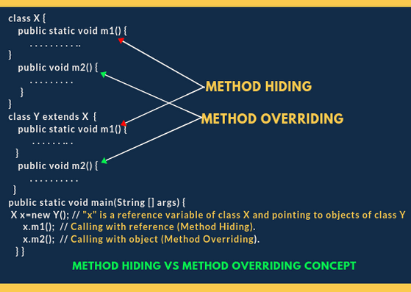
A real example of Java Method Overriding

Slide 14
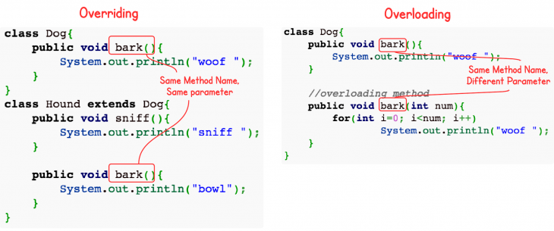
Method overriding vs overloading

Slide 15
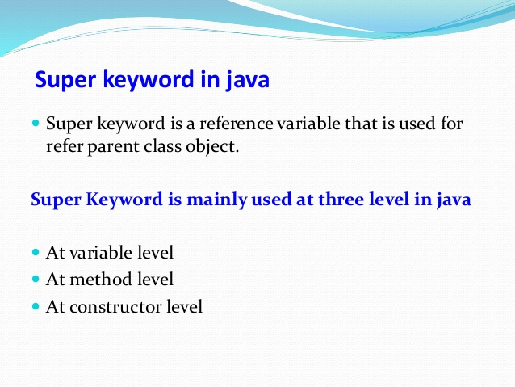
Super Keyword in Java :
The super keyword in Java is a reference variable which is used to refer immediate parent class object.
Usage of Java super Keyword
super can be used to refer immediate parent class instance variable.
super can be used to invoke immediate parent class method.
super() can be used to invoke immediate parent class constructor.

Slide 16
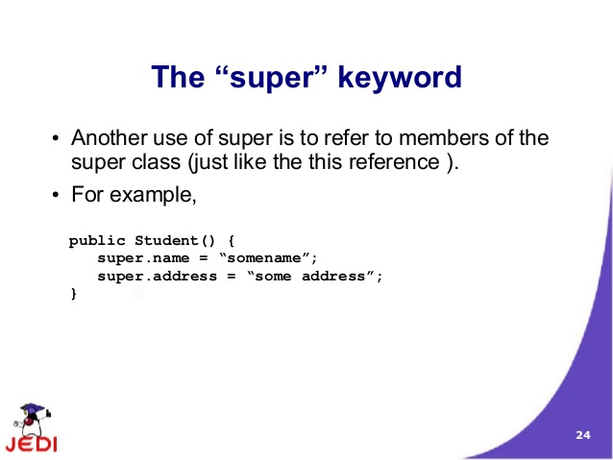
Super Keyword Example :

Slide 17
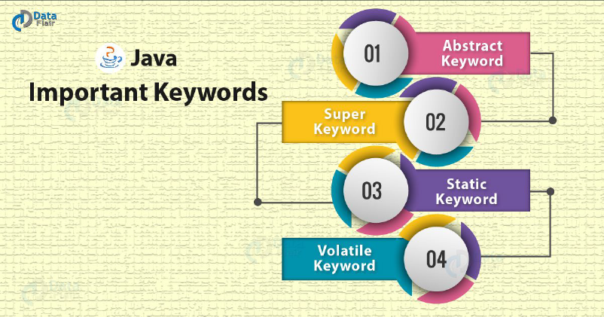
Java important keywords :

Slide 18
super is used to refer immediate parent class instance variable.
class Animal{
String color="white";
}
class Dog extends Animal{
String color="black";
void printColor(){
System.out.println(color);//prints color of Dog class
System.out.println(super.color);//prints color of Animal class
}
}
class TestSuper1{
public static void main(String args[]){
Dog d=new Dog();
d.printColor();
}}

Slide 19
Final Keyword In Java
The final keyword in java is used to restrict the user. The java final keyword can be used in many context. Final can be:
1. variable
2.method
3. class

Slide 20
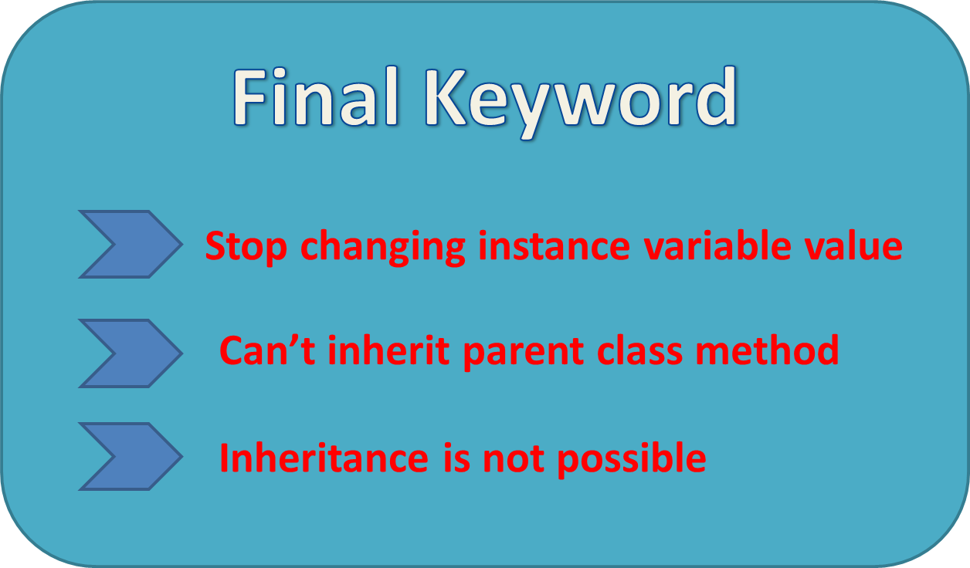
Java final variable

Slide 21
Example of final variable
class Bike9{
final int speedlimit=90;//final variable
void run(){
speedlimit=400;
}
public static void main(String args[]){
Bike9 obj=new Bike9();
obj.run();
}
}

Slide 22
Java final method
If you make any method as final, you cannot override it.

Slide 23
Example of final method
class Bike{
final void run(){System.out.println("running");}
}
class Honda extends Bike{
void run(){System.out.println("running safely with 100kmph");}
public static void main(String args[]){
Honda honda= new Honda();
honda.run();
}
}

Slide 24
Java final class
If you make any class as final, you cannot extend it.

Slide 25
Example of final class
final class Bike{}
class Honda1 extends Bike{
void run(){System.out.println("running safely with 100kmph");}
public static void main(String args[]){
Honda1 honda= new Honda1();
honda.run();
}
}

Slide 26


